Slide 1
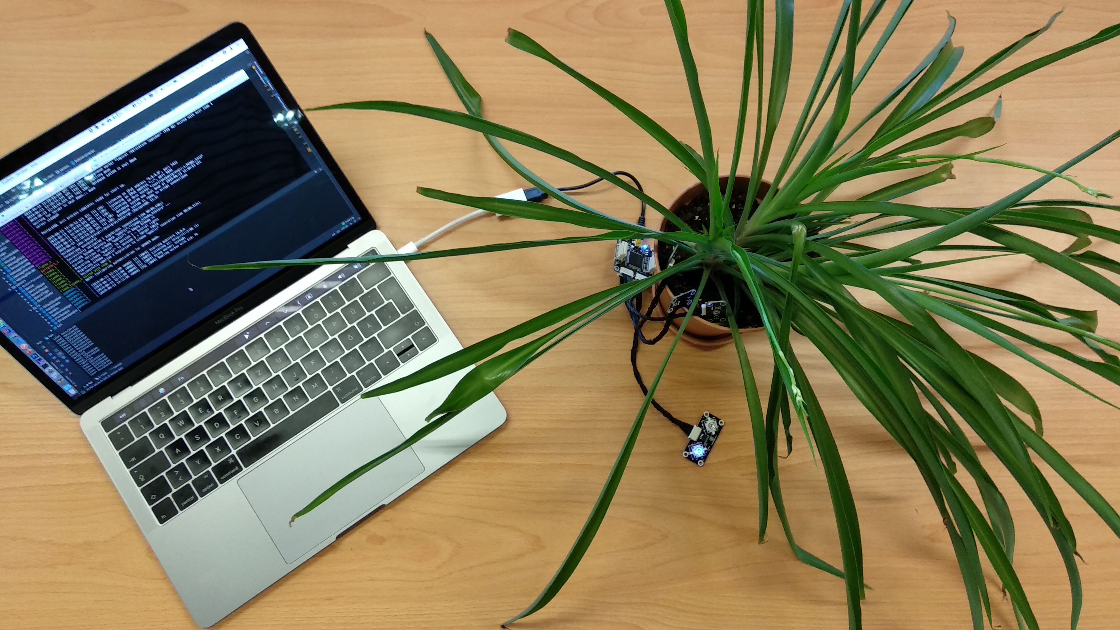

Fog Computing prototype
Jasper Bernhardt
Elias Grünewald
Fabian Lehmann
Summer term 2019
Notes:
Sample Size of Notes

